Slide 1
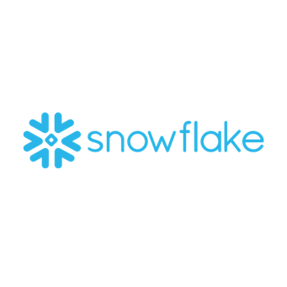


Atrium Staffing – Snowflake Implementation
Business Need​
Atrium Staffing was looking for a vendor to create a low maintenance cloud data warehouse and ELT solution for their Enterprise reporting. They leverage two critical business operation platforms where the data lives and is only accessible through export to excel for reporting and analysis. This all needed to be accomplished and maintained with no IT support.​
​
What We Did ​
Affirma setup and configured the ELT layer in Fivetran and a new reporting database in Snowflake.​
Implemented a low maintenance structure, with incremental loads from their two business operation systems and Great Plains leveraging Fivetran.​
​
Result​
Increased control of data and flow for Atrium by 300%.​
Allowed Atrium to create repeatable reporting with no manual data export in PowerBI.​
​
Now​
Continued support with an onshore lead and offshore dev for Snowflake, Fivetran and PowerBI

